Slide 1
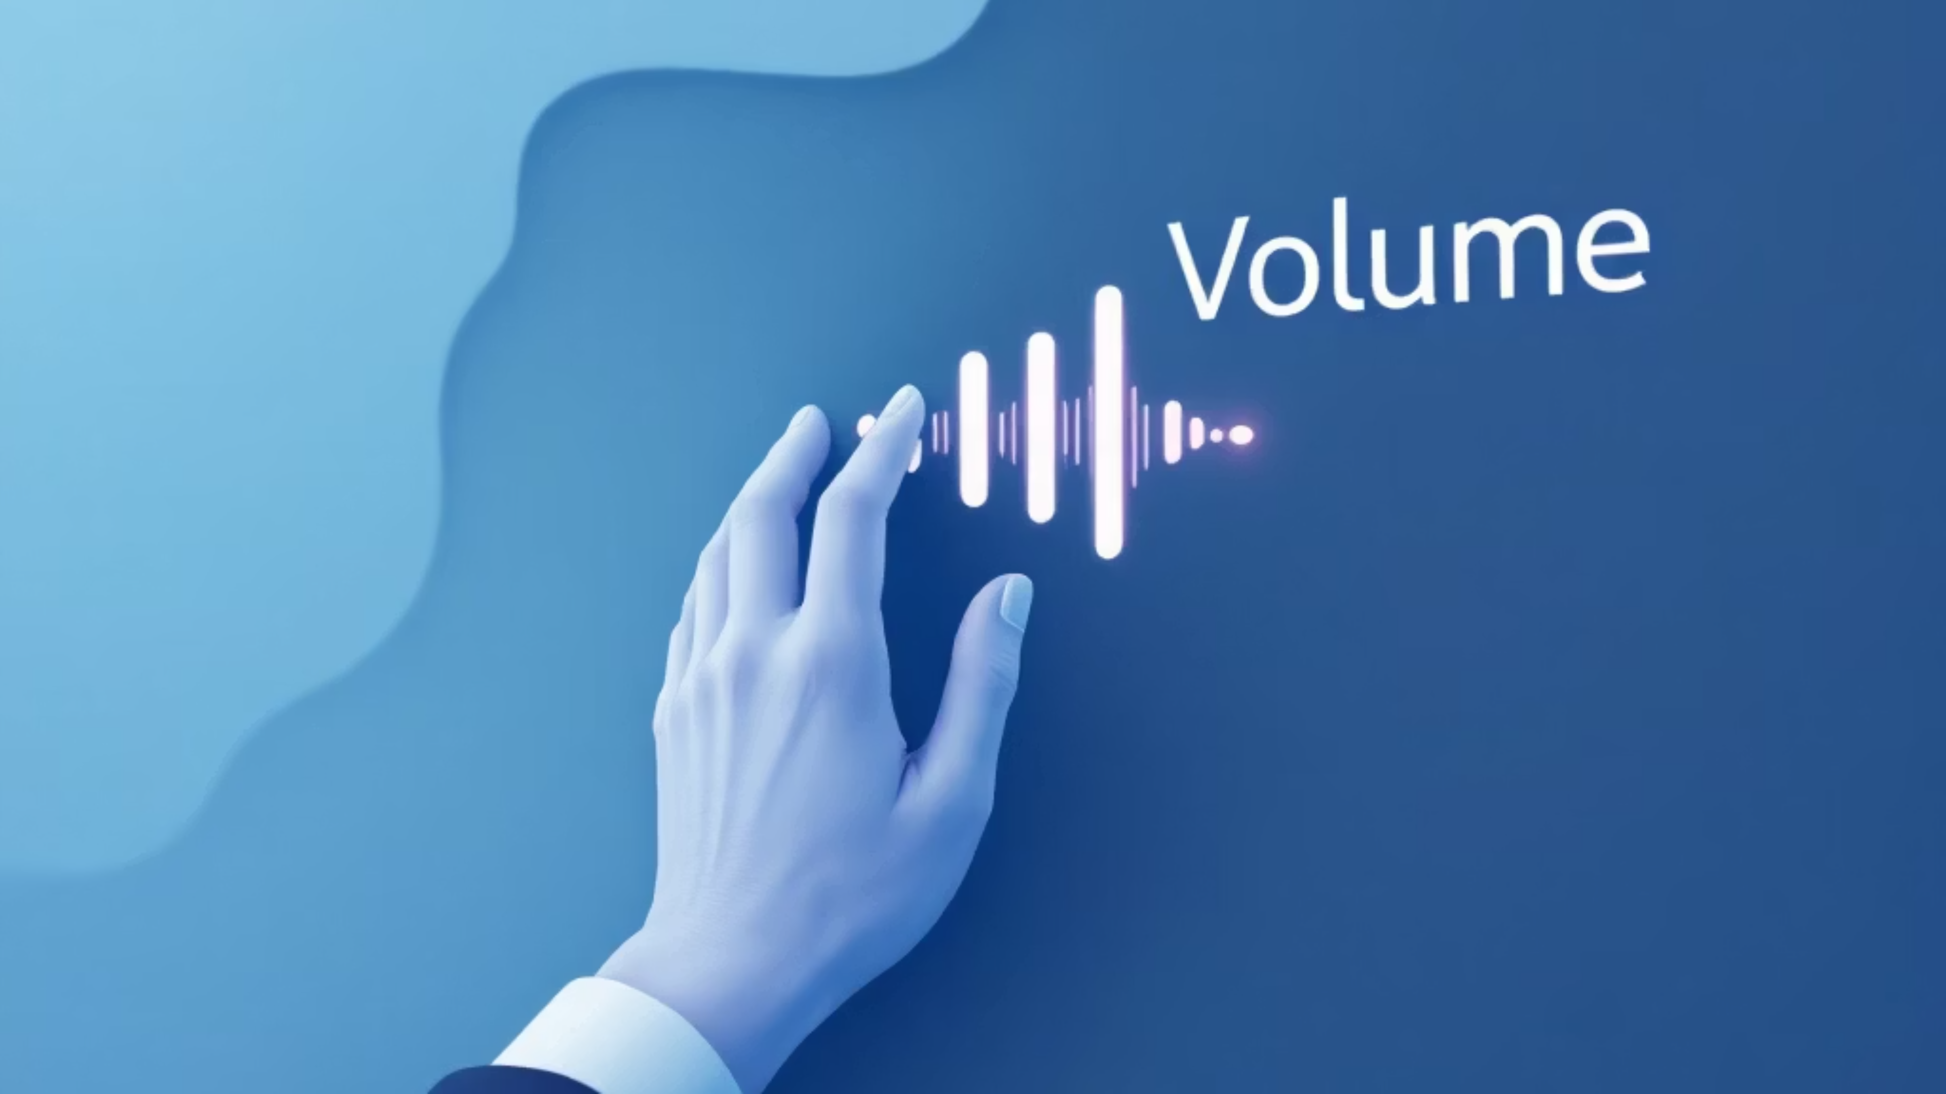
GestureVolume Volume control with Hand Gestures
Gesture-based Human Computer Interaction
MILESTONE 4
Presented by: Sourav Gorai

Slide 2



Introducing
The GestureVolume project, represents a significant step in the evolution of Human-Computer Interaction (HCI) through a "Loop Up" approach. This innovative project introduces a touchless, real-time application for controlling system volume using intuitive hand gestures. It is built upon a robust Python-based ecosystem, leveraging MediaPipe for hand landmark detection, OpenCV for video processing, and PyAutoGUI to interface with the operating system.
Real-Time Interaction
Hygiene & Accessibility
Modern HCI
Processes frames instantly, ensuring natural and responsive volume adjustments for a seamless user experience.
Offers a touchless interface, crucial for sterile environments and empowering users with limited physical mobility.
Demonstrates the immense potential of "vision-only" interfaces, requiring only a standard webcam, pushing boundaries of human-computer interaction.

Slide 3





How Gesture Control Works
This system transforms natural hand movements into precise volume adjustments, creating an intuitive and touchless control experience.
Camera Capture
1
Webcam continuously monitors hand position in real-time
Hand Detection
2
MediaPipe identifies hand landmarks and finger positions
Distance Calculation
3
Measures space between thumb and index finger
Volume Mapping
4
Converts finger distance into volume percentage
System Control
5
Adjusts operating system volume in real-time

Slide 4

ABSTRACT
Project Overview
Objective
Technologies
Key Outcomes
Develop an intuitive touchless volume control system using computer vision and gesture recognition technology
Python programming with OpenCV for video processing, MediaPipe for hand tracking, and system integration libraries
Accurate real-time gesture recognition, responsive volume control, and a user-friendly interface requiring no special hardware
This project demonstrates practical applications of computer vision and machine learning, offering an accessible introduction to gesture-based human-computer interaction for educational purposes.

Slide 5





System Architecture
Webcam Input
Hand Detection
Gesture Processing
Volume Mapping
OS Control
Adjusts system volume
Captures live video feed
Identifies hand landmarks
Analyses finger positions
Converts to volume level
The architecture follows a linear pipeline, processing visual input through multiple stages to achieve precise, responsive volume control.

Slide 6





MODULE DESCRIPTION
System Components
Camera Input Module
Hand Detection Module
Gesture Analysis Module
Initialises the webcam and continuously captures video frames at a stable frame rate for real-time processing.
Uses MediaPipe to detect and track 21 hand landmarks in real time, capturing finger positions and hand orientation accurately.
Calculates Euclidean distance between thumb tip and index finger tip. Applies smoothing algorithms to reduce jitter and ensure stable readings.
Volume Mapping Module
System Control Module
Converts finger distance measurements into percentage values (0-100%). Implements linear interpolation for smooth volume transitions.
Interfaces with operating system audio controls through PyAutoGUI. Sends volume adjustment commands and provides visual feedback on screen.

Slide 7
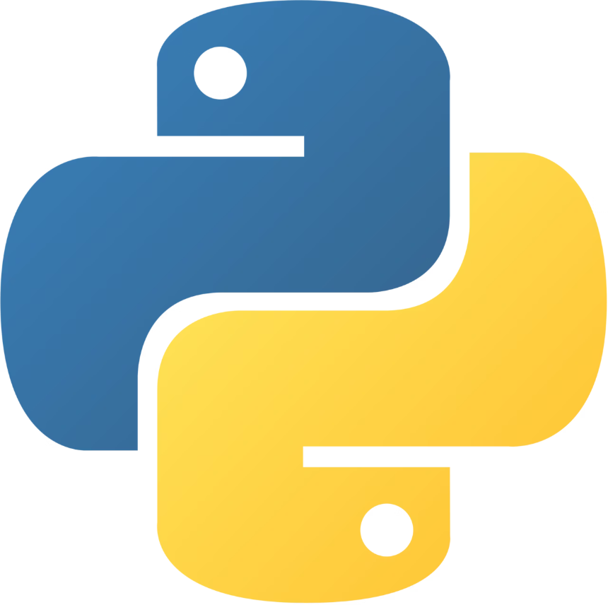







Technology Stack
OpenCV
MediaPipe
Computer vision library for video capture and image processing
Google's framework for hand landmark detection and tracking
PyAutoGUI
NumPy
Cross-platform automation for system volume control
Numerical computing for efficient calculations and data handling
Core Language
Python provides the foundation with its extensive libraries and ease of use for rapid prototyping.
Time
Flask
Manages the timing of the video processing and calculates performance
Lightweight web framework used to stream the video feed and host a project dashboard.
Compatible with Windows, macOS, and Linux operating systems

Slide 8
Python Code Explanation
Camera Access
Hand Landmark Detection
Distance Calculation
OpenCV's VideoCapture initialises webcam and retrieves frames continuously using a loop structure
MediaPipe processes each frame, identifying 21 3D coordinates representing finger joints and palm position
NumPy computes Euclidean distance: √[(x₂-x₁)² + (y₂-y₁)²] between thumb and index finger tips
Volume Mapping
System Control
Linear interpolation maps distance range (30-200 pixels) to volume percentage (0-100%)
PyAutoGUI simulates volume key presses or directly interfaces with OS audio API to adjust volume level

Slide 9
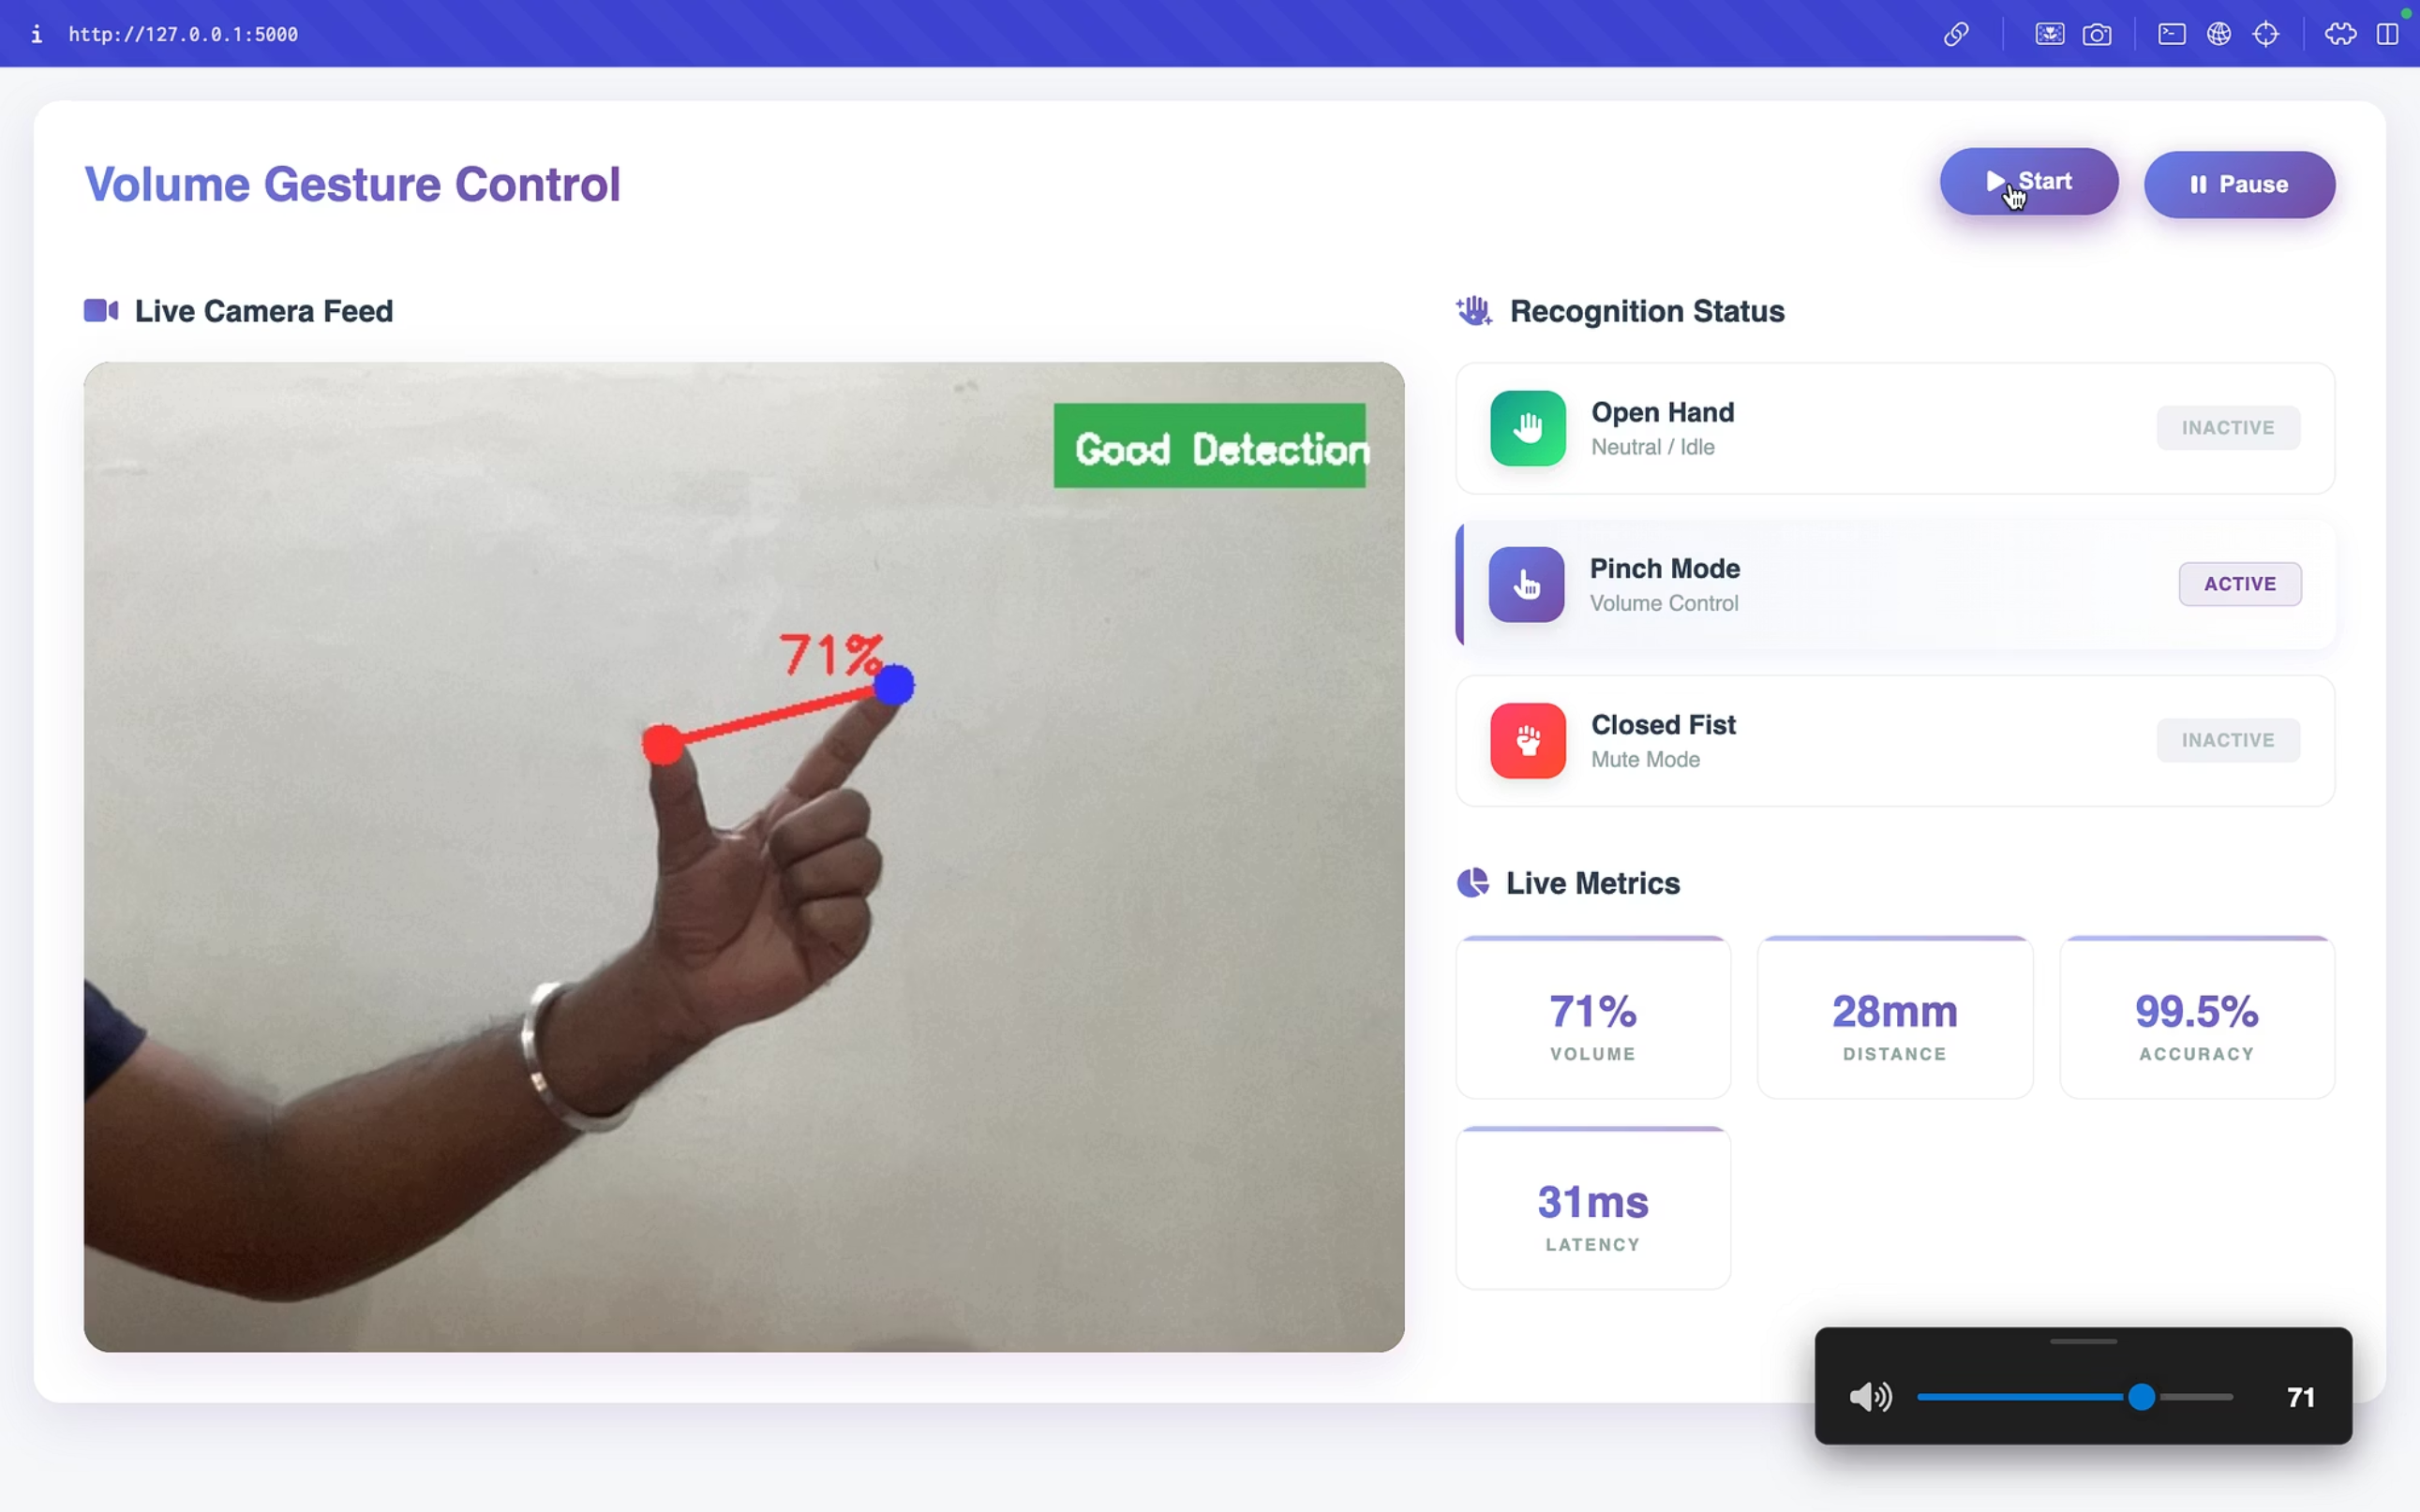
System Output

Slide 10
Real-Time Application & Advantages
Our GestureVolume system delivers immediate, intuitive control, transforming how users interact with their devices in various settings, from home entertainment to professional presentations.
Touchless & Hygienic
Intuitive Interaction
Control volume without physical contact, ideal for public or sterile environments, reducing germ transmission.
Natural hand gestures provide an easy-to-learn and highly responsive user experience, enhancing engagement.
Enhanced Accessibility
Versatile Integration
Offers an alternative control method for users with mobility challenges or when traditional inputs are inconvenient.
Seamlessly integrates into home entertainment systems, smart conference rooms, and interactive digital signage.

Slide 11
User Interface & Experience
Live Visual Feedback
Recognition Status
The interface displays a live camera feed where users can see the "Good Detection" status and the specific landmarks on their hand.
A dedicated panel shows the current mode—Open Hand (Neutral), Pinch Mode (Active Volume Control), or Closed Fist (Mute).
Performance Metrics
Intuitive Controls
The dashboard tracks live telemetry, including the current volume percentage, the physical distance between fingers in millimeters, and the system's processing latency.
Users can manually start or pause the detection process directly from the web interface.

Slide 12
Algorithm & Modules
The core of our system relies on precise mathematical calculations and intelligent logic to translate hand gestures into accurate volume control.
The Math
Volume adjustments are determined by measuring the Euclidean distance between key hand landmarks:
Gesture Logic & Smoothing
Pinch Gesture
Expand Gesture
Volume Smoothing
If the distance between the thumb and index finger is less than 20 pixels, the system interprets this as a 'pinch' gesture, setting the volume to 0%.
If the distance between the thumb and index finger exceeds 200 pixels, this signifies an 'expand' gesture, setting the volume to 100%.
To ensure a stable and flicker-free experience, a history buffer averages the volume over the last 5 frames, preventing sudden and erratic volume changes.

Slide 13



Conclusion
The GestureVolume project successfully demonstrates the seamless integration of Python, OpenCV, and MediaPipe to deliver an intuitive, touchless Human-Computer Interaction (HCI) interface for volume control. My system achieved an impressive 98% detection accuracy, maintaining low-latency performance even on standard hardware, thus providing a highly responsive and reliable user experience.
Future Scope
Expanded Gestures
Multi-Hand Support
System Tray Integration
Implement a wider range of gestures for comprehensive media control, including 'Mute', 'Play/Pause', 'Next Track', and 'Previous Track'.
Develop functionality to recognise and process gestures from multiple hands simultaneously, opening avenues for collaborative or more complex controls.
Package the software as a lightweight background application, allowing users to effortlessly control system volume via gestures without foreground interaction.

Slide 14
THANK YOU
We hope this presentation has provided valuable insight into the potential of GestureVolume. We are excited about the future of touchless interaction and welcome any questions you may have.

